Slide 1
CIP - Customer Intelligence Platform
23rd December 2021

Slide 2


Index
1. Customer Intelligence Platform [CIP] Overview
2. CIP – Key Accomplishments
3. CIP User Data Fetcher
4. Phone & Email Encryption for Snapchat integration extended to multiple brands
5. Phone & Email Encryption for Facebook integration extended to multiple brands
6. ADA model Usage Tracker
7. Offline Payments submission for Snapchat and Facebook (for ONTARIO Label)
8. Real Time CRM Dashboard - new US labels
9. CIP Monitoring
10. Audience uplift for grandstand campaigns
11. Fan zone 1.0
12. CIP Roadmap projects - 2022
Notes:
Four key points

Slide 3
Customer Intelligence Platform – Overview
Customer Intelligence
Customer intelligence (CI) as part of business intelligence is the process of gathering and analyzing information regarding customers, and their details and activities, to build deeper and more effective customer relationships and improve decision-making.
Centralized Realtime Data
Customer Behavioral and Transactional realtime data
Sports Trading Data – LadCor (Implementation complete), Entain Labels (Work In Progress)
Integrations with multiple systems
Established – ADA (CASIA / SIA), Entain Platform, Sports, LCG Platform, Openbet, BI, Optimove, Graphyte, Adobe, SFMC, Grandstand, Facebook, Snapchat, AppsFlyer, Google Analytics
In Pipeline (till date) – Twitter, POS
Notes:
Four key points

Slide 4












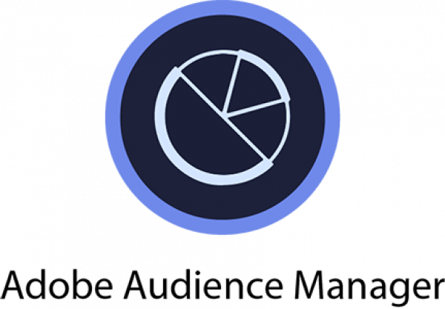







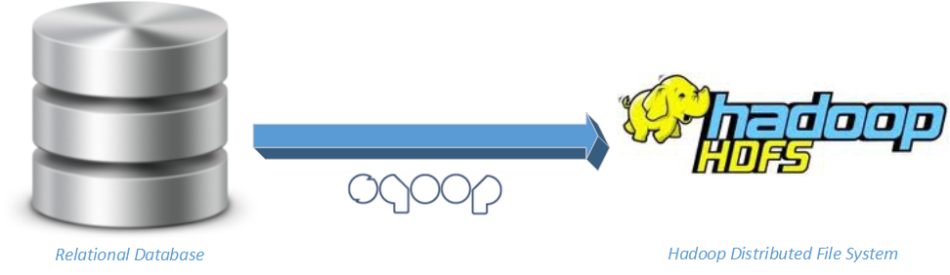


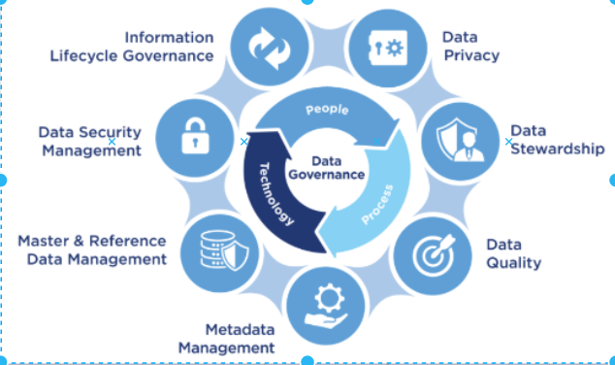




Customer Intelligence Platform [CIP]
EXTERNAL APPLICATIONS (OB, PLAYTECH)
DATA LAKE
2
1
Raw Zone
Cleanse Zone
Production Zone
microservices
NON-US APPLICATIONS
Entain Data
Teradata/Excels/Csvs
US APPLICATIONS
3
2
1
AI/ML (Apache Spark )
microservices
Notes:
Four key points

Slide 5
CIP Key Accomplishments
CRM Dashboard: Single interface for marketing / Ops users for tracking and monitoring all CRM campaigns, rewards with realtime alerting mechanism. Additionally provides details statistics on Player logins, Cashier deposits / withdrawals, Active players etc.,
Notes:
Four key points

Slide 6
CIP Deliverables
Notes:
Four key points

Slide 7


Ladbrokes SIA
Business use case
Technical description
Problem description: Currently, we don’t have bet recommendations for sports which would help to target players with personalized recommendations.
Label(s) impacted: All Ladbrokes & Coral Label.
Action taken: Consuming the Bet Placement, Bet Settlement, Payout Status, Event, Market, Selection, Oxirep-Commentary messages events in Realtime from Open bet over DF Kafka and made available for Model consumption, which generates bet recommendations to the players.
Business benefit: Significantly more personalized customer experience and increase in CTR (click through rate).
Architecture/Design: CIP consumes this data from DF Kafka and made available for model.
Source Events: Bet Placement, Bet Settlement, Payout Status, Event, Market, Selection, Oxirep-Commentary messages.
Notes:
Four key points

Slide 8
Hadoop
Business use case
Technical description
Problem description: We don’t have any system to execute ML,AI models to generate recommendations to understand the player behaviour.
Label(s) impacted: All GVC,LCG,US Label.
Action taken: Built Hadoop Infrastructure which has ML,AI capabilities for running ML models for generating Game, Sports recommendations.
Business benefit: Based on players behavior we can show the personalized games,sports to the players which would significantly improve CTR,
Architecture/Design: Built the Hadoop with Components HDFS, Yarn, Spark, Hive, Hue.
HDFS: HDFS is Hadoop filesystems to store the transactional, Behavioral data.
Spark: Spark is a fast and general processing engine compatible with Hadoop data.
Yarn: Yarn manages the resources in the Hadoop cluster.
Hive: Hive gives an SQL-like interface to query data stored in various databases and file systems that integrate with Hadoop. Hue: Hue is a web-based tool to access the data from Hadoop and provide the visualizations instantly.
Hue: Hue is a web-based tool to access the data from Hadoop and provide the visualizations instantly .
Notes:
Four key points

Slide 9
ARC Project
Business use case
Technical description
Problem description: In order to provide data to ML models and to ensure safer gambling, we need to provide the players’ behavioral and transactional data.
Label(s) impacted: GVC,LCG Label.
Action taken: Consuming the Bet Placement, Bet Settlement, Login, Deposit, Withdrawal, Redeem, Payout, Promo, Bonus, Wallet events and players’ behavioral events in Realtime from GVC,LCG Data centers for Model consumption.
Business benefit: Players can see the personalized recommendations of sports/games and also these models would enforce safer gambling.
Architecture/Design: CIP consumes below events in Realtime from GVC, LCG data centers over Analytics ESB.
Source Events: Bet Placement, Bet Settlement,Login,Deposit,Withdrawal,Redeem,Payout,Promo,Bonus,Wallet events and players’ behavioral events .
Notes:
Four key points

Slide 10
US Realtime transactional data
Business use case
Technical description
Problem description:
In order to provide data to ML models and to ensure safer gambling, we need to provide the players’ behavioral and transactional data.
Label(s) impacted: ALL US Label.
Action taken: Consuming the Bet Placement, Bet Settlement, Login, Deposit, Withdrawal, Redeem, Payout, Promo, Bonus, Bingo, Wallet events , players’ behavioral events in Realtime from ALL US Data centers for Model consumption.
Business benefit:
Players can see the personalized recommendations of sports/games and also these models would enforce safer gambling.
Architecture/Design: CIP consumes below events in Realtime from different US data centers over Analytics ESB.
Source Events: Bet Placement, Bet Settlement, Login, Deposit, Withdrawal, Redeem, Payout, Promo, Bonus, Bingo, Wallet events and players’ behavioral events.
Notes:
Four key points

Slide 11
Live Casino
Business use case
Technical description
Problem description:
This is to bring back the Casino players who left the platform, by awarding them with a bonus.
Label(s) impacted: All LCG label.
Action taken: Identity players who are not online, but they are supposed to be online, award them a bonus.
Business benefit: To Reactivate/Retain players.
Architecture/Design: CIP consumes recommended players from ADA models for bonus rewarding and post these events to SFMC over HTTP for Realtime rewarding and communication.
Notes:
Four key points

Slide 12
Performance Improvements
Business use case
Technical description
Problem description: To avoid lag in sending Transactional/Behavioral data to Casia & Graphyte analytic systems
Label(s) impacted: All labels.
Action taken: Identified the bottlenecks in the entire pipeline and improved.
Business benefit: By the above solution, now the system can provide sports/games recommendations instantly
Architecture/Design: Scaled Services Vertically, horizontally, fixed performance bottle necks in different services in the pipeline.
Source Events: Bet Placement, Bet Settlement, Login, Deposit, Withdrawal, Promo, Bonus, Wallet events, Behavioral events.
Notes:
Four key points

Slide 13
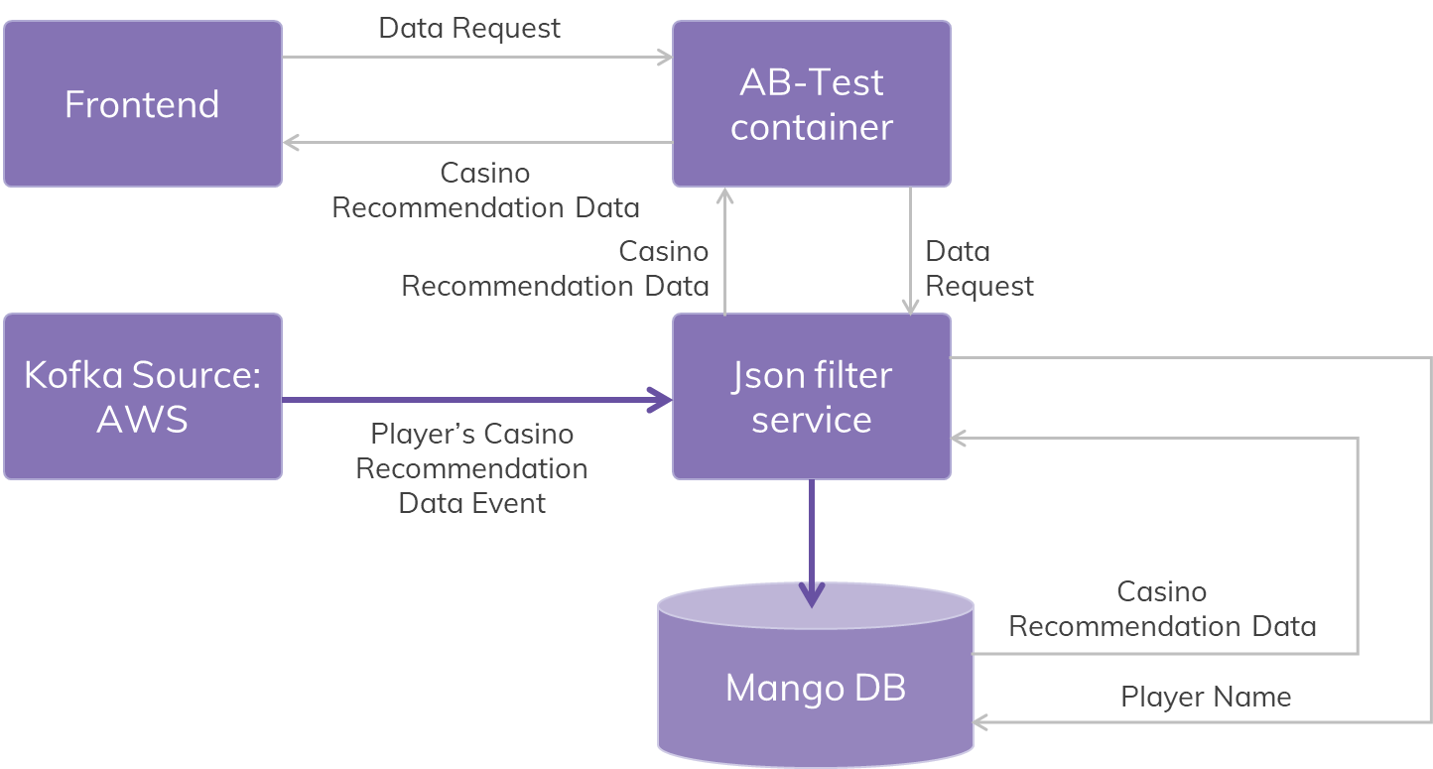
Stream AWS Casia model data & serve through API / CASIA-CASINO Recommendation Data Routing to DCRM (Optimove)
Business use case
Technical description
Problem description: Expose API for casino games home page personalization for A/B test usecases.
Routing casino recommendation events from ADA to platform (DCRM) with help of analytics ESB.
Label(s) impacted: bwin.es.
Action taken:
Streamed the AWS casino recommendations & persisted in MongoDB.
Exposed API to provide recommendations to frontend.
Player can see game recommendations as per events received from ada Improves the business.
Routing Casia-Casino Recommendation to DCRM platform.
Business benefit: Player's casino homepage is personalized based on his behavioral activities.
Source Events:
casino hand complete and login complete events,
Events are collected from ADA.
Recommendation events are collected from ADA .
Feedback Events: casino game recommendations for each player.
Architecture diagram:
Notes:
Four key points

Slide 14
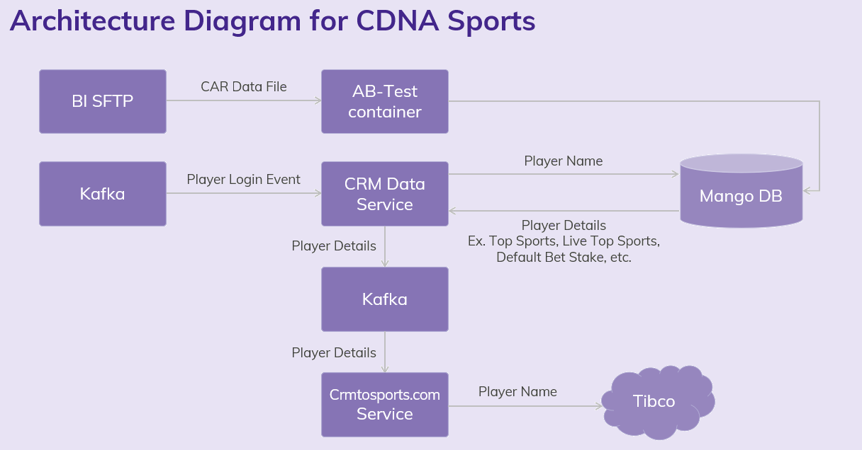
CDNA Sports
Business use case
Technical description
Problem description: To recommend Top Sports, Live Sports, Default Bet Amount to the players.
Label(s) impacted: bwin.com.
Action taken: Consume Top Sports, Live Sports, Default Bet Amount from CAR data file from BI and serve this data to sports team through Tibco.
Business benefit: Recommendation of Top Sports, Live Sports, Default Bet Amount to the players will be provided based on his behavioral activities.
Architecture/Design: Every day BI pushes CAR data file to SFTP, CIP processes this file and persists the data into Mongo DB. On every login CRM data service will fetch the data from mongo and sends to crmtosportscomm, crmtosportscomm publishes data to sports Tibco..
Notes:
Four key points

Slide 15
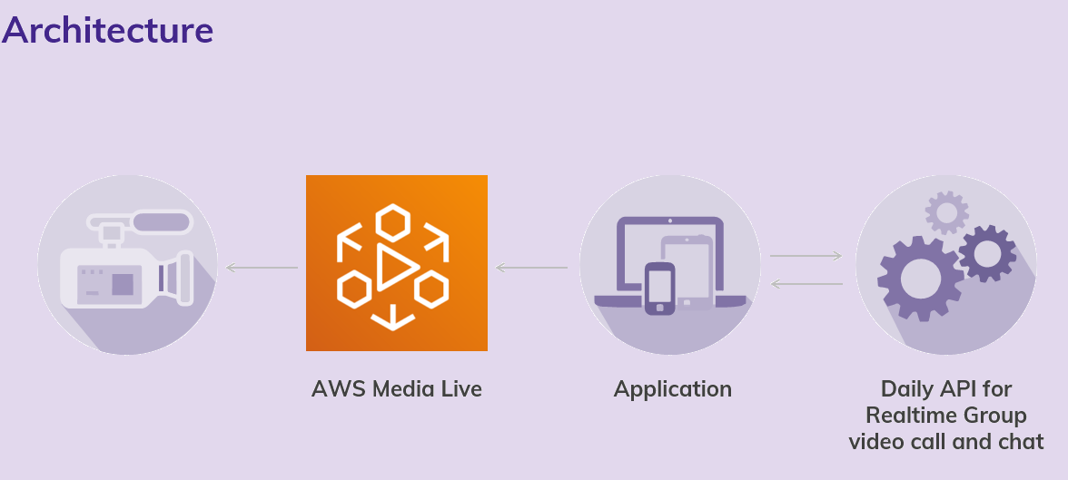
Stream and Bet
Business use case
Technical description
Problem description: Allowing the user for chatting while streaming , allowing the multiuser sync while streaming.
Below is the process of consuming the data.
Consuming the live feed via Aws Media Live.
Using the daily api for real time group video and chat.
created application that consume live video from AWS and uses the Daily api for Realtime group video and chat.
Notes:
Four key points

Slide 16
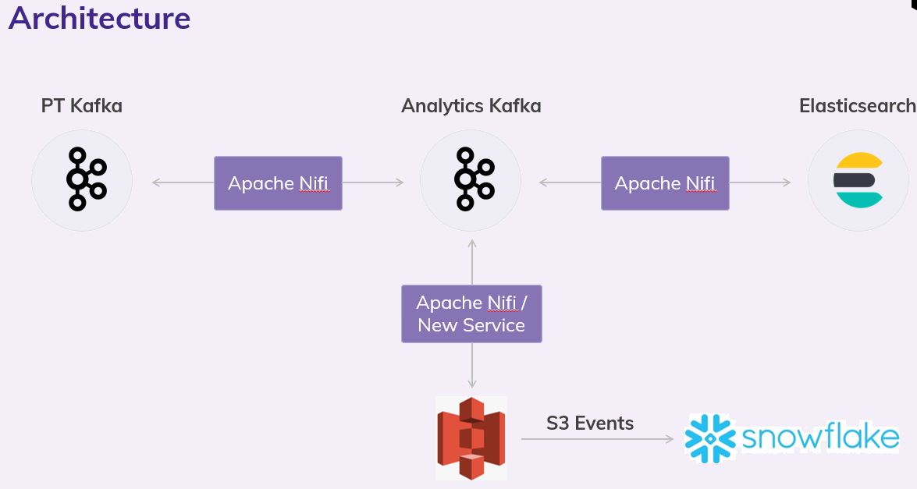
Play Tech integration
Business use case
Technical description
Problem description: Playtech exposes a rich API for live casino. The request is to bring this data into a data store that is accessible to Analysts and from which they can create dashboards to support Casino operations.
Business benefit: Analysts can visualize the data and make necessary recommendations to support casino operations.
Below is the process of consuming the data.
Consuming the data from Playtech Kafka and pushing to S3.
Snowpipe has been configured at the snowflake side which will be listening to S3 events and consume the data as they appear
Notes:
Four key points

Slide 17
Phone & Email Encryption for Snapchat integration
Business use case
Technical description
Problem description: Phone and Email details of players are sent to Snapchat for audience segmentation.
Label(s) impacted: Entain and LCG labels players data are sent.
Action taken: AAM Segmented audience created at Snapchat , encrypted player mobile, email details are sent to Snapchat to segmented audience.
Business benefit:
By sending this information to Snapchat , players can see the advertisements related to Entain games/promotions.
Source Events: AAM segmented players list is collected with help of DMP Destinations, and these players are used to create Snapchat segmented audience.
Architecture:
Adobe DMP
Data Central Exchange
Kafka
DUS
Snapchat
Mango DB
SQL DB
Notes:
Four key points

Slide 18
Scout Integration
Business use case
Technical description
Problem description: To identify the anti money laundering players and take a corrective action to avoid these in future.
Label(s) impacted: All major locations in UK
Action taken: Detecting fraudulent players , money laundering identification.
Business benefit: System can identify the fraudulent players and take a corrective action to avoid these in future.
Source Events: Player data collected from BI is used for triggering Scout API end points.
Notes:
Four key points

Slide 19
Long Sessions
Business use case
Technical description
Problem description:
In order to enforce a break during the long play duration for safer gambling.
Label(s) impacted: LCG.
Action taken: ADA model calculates the player’s active session time between login and logout and sends the session active time for every 5 minutes.
Business benefit: Duration of play time is tracked to enforce a break to avoid addiction to gambling for player’s safety in regards to health and wealth.
Architecture: CIP consumes long session events from ADA models and passed to platform team. Then players break time will be enforced.
Source Events: Long Session events are routed to platform with help of analytics ESB.
Feedback Events: ACTIVE_SESSION_DURATION_EVENT.
Notes:
Four key points

Slide 20
Play Breaks
Business use case
Technical description
Problem description: Play Break alerts will be triggered to players based on configuration done by players. These alerts notify the players to take a break.
Label(s) impacted: LCG labels.
Action taken: Restricted the player from playing continuously.
Business benefit: As per the regulatory requirement, and responsible gambling firm perspective, user is saved from Bankruptcy by applying a break to his continuous play.
Architecture: CIP consumes PlayBreak events from ADA models and passed to platform team. Then players break time will be enforced at the front end.
Source Events: Player break events are routed to platform with help of analytics ESB.
USER_INTERACTION_FEEDBACK_EVENT,BREAK_ENFORCEMENT_EVENT, BREAK_TERMINATION_EVENT, BREAK_WHITELIST_ADD_EVENT, BREAK_WHITELIST_REMOVE_EVENT,PLAY_BREAK_CHANGE_EVENT.
Feedback Events: THRESHOLD_BREACH_EVENT.
Notes:
Four key points

Slide 21
CASIA - 7302 - Risky Games (E-34559)
Business use case
Technical description
Problem description:
System should have capability to recommended safer games to the Players who are losing money while continuously playing certain games.
Label(s) impacted: GVC, LCG, US
Action taken:
CIP consumes risky games from ADA models and serves to Casino further avoiding in displaying these games to players.
Business benefit: A player is recommended with safe games thus by avoiding display of risky games which will benefit them from losing money.
Architecture: CIP consumes risky games from ADA models through analytical ESB and serves to Casino.
Feedback Events: Risky games events are routed with help of analytics ESB to platform.
Notes:
Four key points

Slide 22
Graphyte Integration
Business use case
Technical description
Problem description:
System should have capability to recommend games based on their behavior.
Label(s) impacted: All Labels.
Action taken: Sending the player’s behavioral data to Graphyte system.
Business benefit: Significantly more personalized customer experience and increase in CTR (click through rate).
Architecture: Snowplow services collects the player’s behavioral data from front end and send this data to Graphyte.
Source Events: Deposit, first Deposit, game Open, login Success, pageview, registration Success, withdrawal, game Close.
Notes:
Four key points

Slide 23

Bonus Abuser Model changes with data to Platform
Business use case
Technical description
Problem description:
System should have capability to identify the players who missuses bonus awarding
Label(s) impacted: All Labels.
Action taken: Sending Bonus Abused player details to platform
Business benefit: Prevent awarding of bonus to fraudulent players
Architecture: CIP consumes fraudulent players data from ADA models through analytical ESB and serves to platform.
Source Events: Fraudulent players data is received from ADA and routed through analytical ESB to platform.
Notes:
Four key points

Slide 24
Grandstand Bet Recommendations
Business use case
Technical description
Problem description: Currently, we don’t have bet recommendations for Grandstand users which would help to target players with personalized recommendations.
Label(s) impacted: All Ladbrokes & Coral Label.
Action taken: CIP consumes bet events from Grandstand which are served to ADA models. These models generate the bet recommendations and will be shared to Grandstand for running their campaign.
Business benefit: Personalized customer experience to increase in CTR (click through rate), bet quantity and GGR.
Architecture/Design: Bet Events are sent from Grandstand to Entain Internal Systems, which are evaluated for Bet recommendations by ADA Models. The derived recommendations will be provided back to Grandstand for running their campaigns.
GRANDSTAND
Grandstand API Container
Common Kafka
DUS
ADA
Entain Internal
DUS
GRANDSTAND
ADA
Entain Internal
Notes:
Four key points

Slide 25


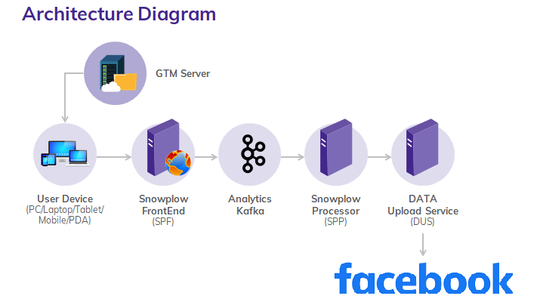
Facebook CAPI
Business use case
Technical description
Problem description: As of we don’t have any relation between our marketing data and the Facebook systems that optimize Ad targeting, resulting in increased cost per action.
Label(s) impacted: Coral , Ladbrokes ,BetMGM ,Borgata ,Bwin (UK, AT, FR, ES, BE, DE, GR, CO, IT, PT, SE) ,Bwin DK ,party poker ,party casino ,Gala Bingo ,Gala Casino ,Gala Spins ,Foxy Bingo ,Foxy Games ,Cheeky Bingo ,Ladbrokes BE.
Action taken: Integrated with Facebook Conversion Api.
Business benefit: Can have optimized Ad targeting , decrease cost per action and measure results.
Architecture/Design: CIP Consumes Betslipadd, Betslip submit, First Time Deposit, Registration Success, Deposit, Game Open, Login from front end through GTM and streams the data to Facebook in realtime.
Notes:
Four key points

Slide 26
SIA: My Marquee A/B Test
Business use case
Technical description
Problem description:
Currently events and markets are shown in marquee page in a generic order that are configured in Sitecore.
Label(s) impacted: bwin.com
Action taken: Consuming the personalized events, markets for each customer from ADA, serve to sports team through Tibco.
Business benefit: Personalized recommendation of relevant events and markets to the customers based on his behavioral activities.
Architecture: CIP consumes events, markets from ADA models and shares to sports team through Tibco.
Source Events: NA
Notes:
Four key points

Slide 27
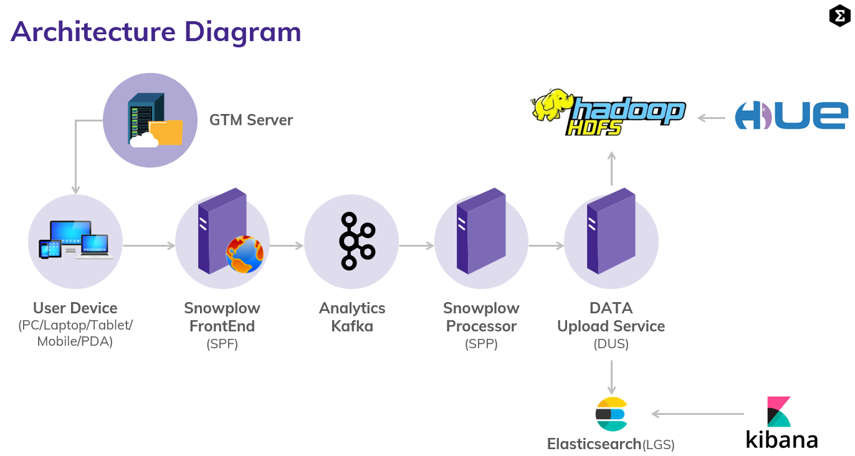
Brute force data loss mitigation
Business use case
Technical description
Problem description: Storing records of access to customer’s account credential stuffing is one of the most usual cyberattack Entain is exposed to. There is no provision to visualize the customer account information during such attacks.
Label(s) impacted: All labels
Action taken:
Implemented a log system capable of identifying attackers having access to customer account information.
Business benefit: We can identify If attackers access the customer account information.
Design: CIP consumes pageview (session_id,account_id, ip_address, datetime_my_account_accessed) events from frontend through GTM, Persist this data in elasticsearch,HDFS and create visualizations through Kibana, Hue.
Notes:
Four key points

Slide 28
CIP Roadmap - 2022
Notes:
Four key points

Slide 29
CIP Roadmap projects - 2022
Project Name | Description
Ladbrokes/Coral-Value Perception | The UK Sports Brands want a way to showcase the value their customers get by surfacing a 'value statement' on site for customers to know what they are getting/could be getting from the promotions available to them.
Server to Server Conversion API (Facebook /Snapchat conversion API) | Integrated with Facebook/Snapchat Conversion Api towards optimizing Ad targeting , decrease cost per action and measure results.
SIA/CASIA cluster – Add more resource to the SIA/CASIA cluster | Scale SIA/CASIA cluster resources
Real Time CRM Dashboard | Single interface for marketing / Ops users for tracking and monitoring all CRM campaigns, rewards with realtime alerting mechanism. Additionally provides details statistics on Player logins, Cashier deposits / withdrawals, Active players etc.,
Make Gaming Bonus Abuser models available in other CRM tools beyond Optimove | Extend the changes done to Bonus Abuser model to EDS
Fan zone 1.0 | CRM automations for Fanzone communications
Automation Of Value statements | Summary of player’s sports rewards through various communication channels for last 30 days.
Audience uplift for grandstand campaigns | Based on players historical betting activity, Grandstand will target the most appropriate campaign(Event/market/outcome) to the user.
Segmentation and personalization of EzNav options LCQ4-12 | All players see exactly the same Eznav Game Proposition options irrespective of their product preference and previous interaction with the menu or current bets. Changes needed to display Eznav menu items that are relevant to the player.
Notes:
Four key points

Slide 30
CIP Roadmap projects - 2022
Project Name | Description
Smart Lobby - Options for fallback | Ability to have fallback mechanism when CASIA returns empty game list for a player
Dynamic Bet - BI/CDNA (Each Player Vs Game Group) | Bet recommendation for CASINO games via CASIA at game type level
Dynamic Bet - CasiA (Each Player Vs Each Game) | Bet recommendation for CASINO games via CASIA at game level
Trading real time data to be made available on ROW brands (mirroring what’s available for Lads and Coral) | Trading Real time data like events/markets/selections/price changes for all Entain labels to be made available for ADA
2022-Q2 Extend Bonus Optimization, to the Casino offers for the regions of LCG, LATAM and Italy | Extend Bonus Optimization models for LCG/LATAM and Italy
Revamp of poker loyalty scheme(Cashback 2.0) | A new poker loyalty scheme, enabling segmented promotions for all labels
2022-Q2 Within Bonus Optimization, communicate to “No Offer” designated Customers. | Send static communication to users with “No Offer” .
Quick Seats Personalization | Players may be directed to a table that is not suited to their usual staking levels. Propose to automatically select a table that corresponds to the usual betting of each individual player.
Notes:
Four key points

Slide 31
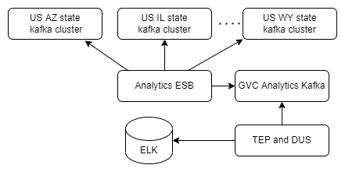
Realtime Dashboard - Addition of new US labels
Business use case
Technical description
Problem description: We are not streaming some of the US states(AZ,IL,LA,MS,NV,NY,DC,WY) events data in the existing system, so we are not displaying those US states data in Realtime dashboard and Ontario labels(ON,OW,OY) are displaying under GVC specific dashboards.
Label(s) impacted: GVC and US.
Action taken: We have created new routes in Analytics ESB to stream data from different US states kafka topics and enabled support in TEP to process different US labels events and configured Ontario labels(ON,OW,OY) under US labels category.
Business benefit: Now we can see above mentioned US states data in Realtime dashboards and Ontario labels data under US dashboards.
Architecture/Design: Analytics ESB will stream different US states data from different US kafka servers and sourcing it to the GVC analytics kafka server and from there TEP and Nifi will do further processing and push necessary events data to Elasticsearch.
Notes:
Four key points

Slide 32
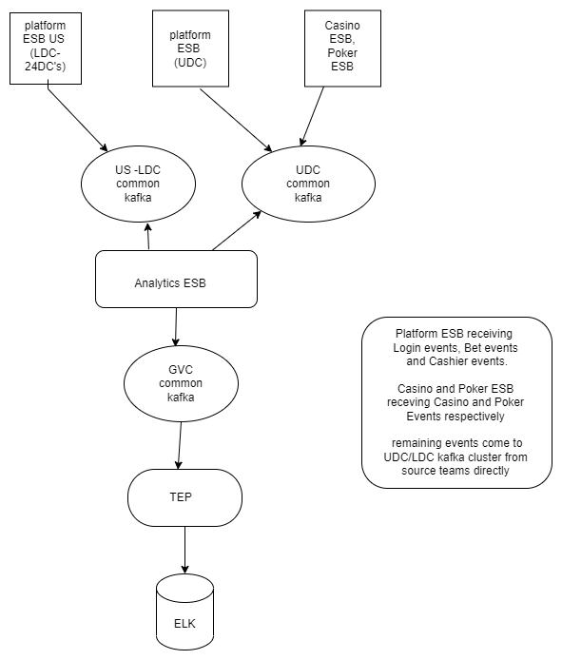
SASW
Business use case
Technical description
Architecture/Design:
Problem description: Once user registered in any US state, user can play games in only that particular state.
Label(s) impacted: US
Action taken: As part of SASW, we have a new setup called UDC, some of the services will be hosted here. From CIP we made changes in Analytics ESB and Platform ESB to stream data from both LDC and UDC setups. Events coming from UDC kafka server: bonus, bet, cashier, eds, login, promo, wallet events Events coming from LDC Kafka server: bingo, casino, poker events
Business benefit: Once user registered in any US state, user can play game in any US state.
Notes:
Four key points

Slide 33
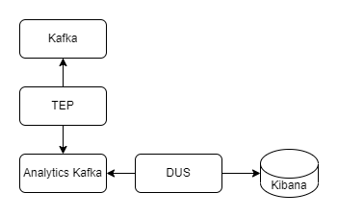
Bet & Get
Business use case
Technical description
Architecture/Design: TEP will consume all Bet and Get events from Kafka and source it to GVC analytics Kafka, from there DUS will process and pushed to Elasticsearch
Problem description: As of now we don’t have the facility to visualize the Bet and Get reward metrics and reports.
Label(s) impacted: GVC, LCG and US labels
Action taken: Created consumers in TEP, to consume all Bet and Get events from Kafka and created new Bet and Get dashboard in Kibana
Business benefit: Business users can see Bet and Get metrics and reports in Kibana dashboard.
Notes:
Four key points

